Slide 1
Reinforcement Learning for Inventory Optimization
Larry Snyder
Professor, Industrial and Systems Engineering
Director, I-DISC
RL for Operations Summer Bootcamp
Northwestern University, Aug. 18, 2022

Slide 2
The Beer Game as a Deep RL Problem
Part 4

Slide 3
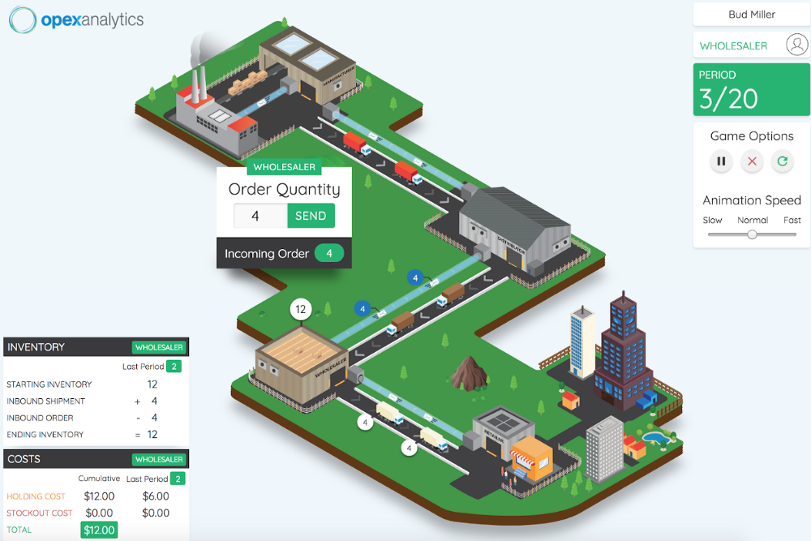
The beer game

Slide 4
The bullwhip effect

Slide 5
Two goals of the beer game
Player’s goal: optimize inventory
Professor’s goal: demonstrate the bullwhip effect
We are interested in the first goal: develop an RL agent to play the beer game

Slide 6
The beer game: literature
The game:
Developed by Forrester and others at MIT in 1950s and 1960s
Sterman (1989): codified rules
Chen and Samroengraja (2000): random-demand version
Martinez-Moyano et al. (2014): history of beer game
Modeling human behavior:
Sterman (1989): proposed model of “irrational” human ordering behavior
Croson and Donohue (2003, 2006), Croson, et al. (2004), Kaminsky and Simchi-Levi (2000), Wu and Katok (2006): experimental behavioral studies
Optimal ordering:
Strozzi, et al. (2007): changing customer demand

Slide 7
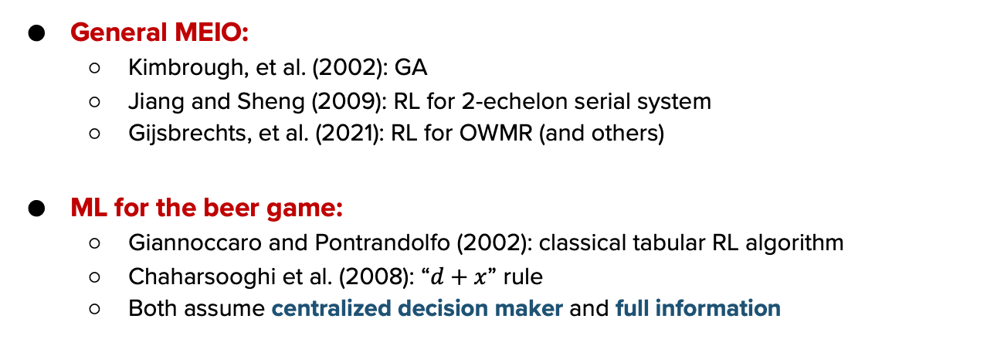
ML for multi-echelon inventory optimization
General MEIO:
Kimbrough, et al. (2002): GA
Jiang and Sheng (2009): RL for 2-echelon serial system
Gijsbrechts, et al. (2021): RL for OWMR (and others)
ML for the beer game:
Giannoccaro and Pontrandolfo (2002): classical tabular RL algorithm
Chaharsooghi et al. (2008): “$d+x$” rule
Both assume centralized decision maker and full information

Slide 8
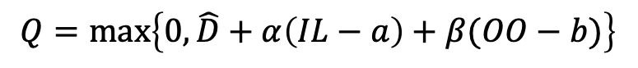
Sterman model
$$Q=max⁡\left\{0, \hat{D}+α\left(IL−a\right)+β(OO−b)\right\}$$
demand
forecast
IL “target”
pipeline “target”
inventory level
on-order (pipeline) inventory

Slide 9
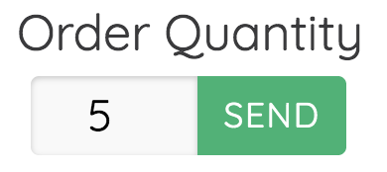

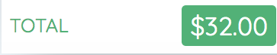

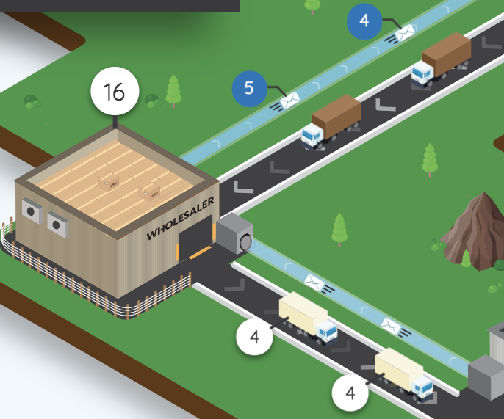
state
agent
action
reward
new reward
new state
environment

Slide 10
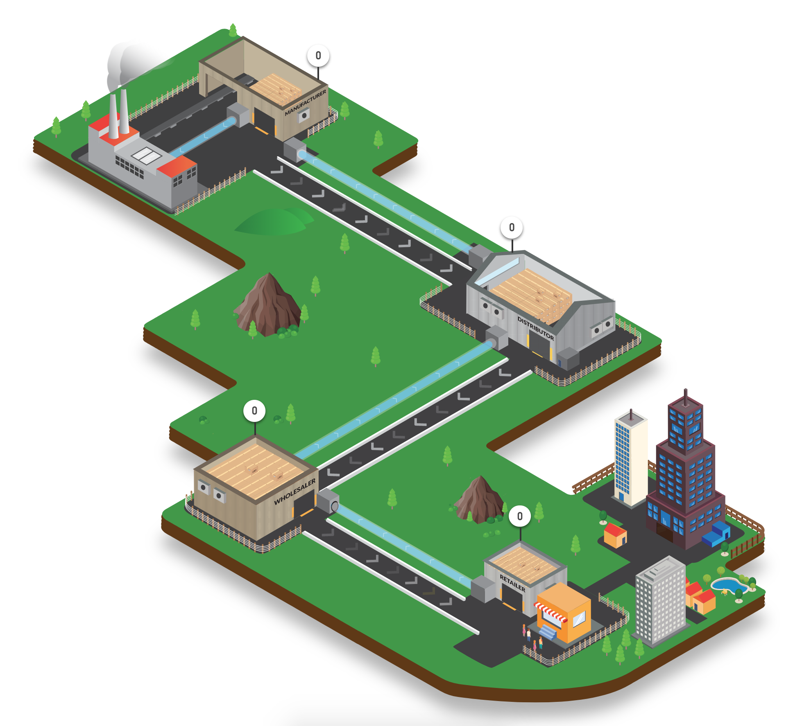
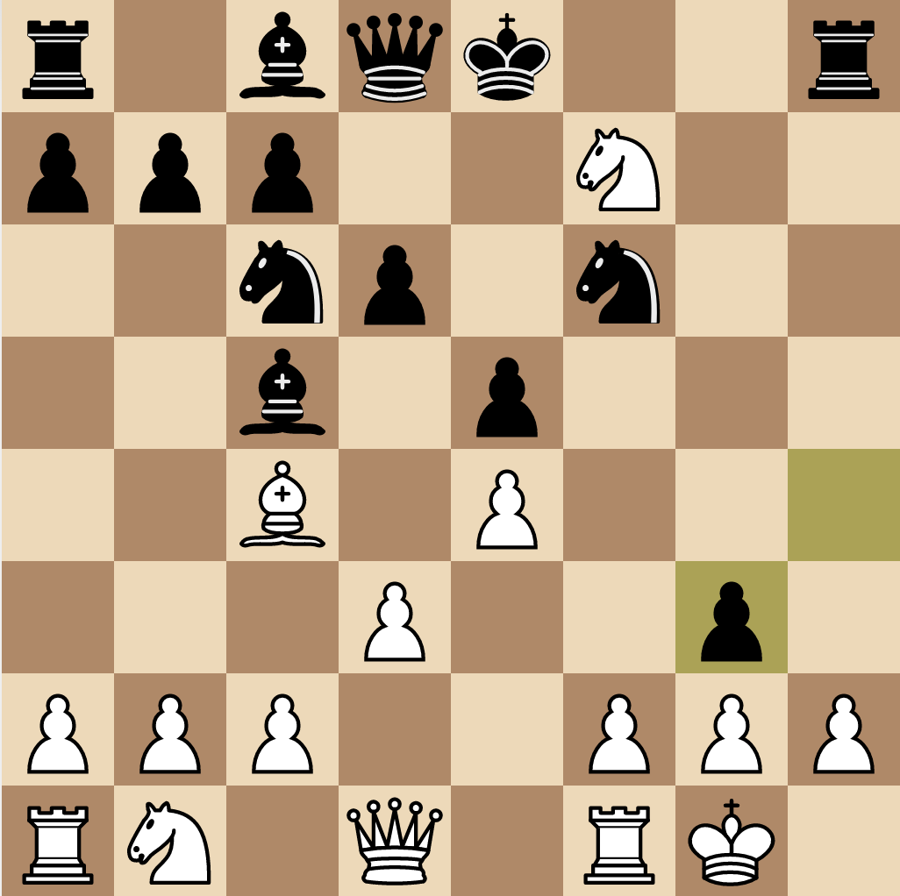
Beer game vs. Atari, etc.
Competitive
Zero-sum
Full information
Instant reward signal (Atari)
Cooperative
Non-zero-sum
Partial information
Delayed reward signal

Slide 11
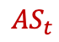
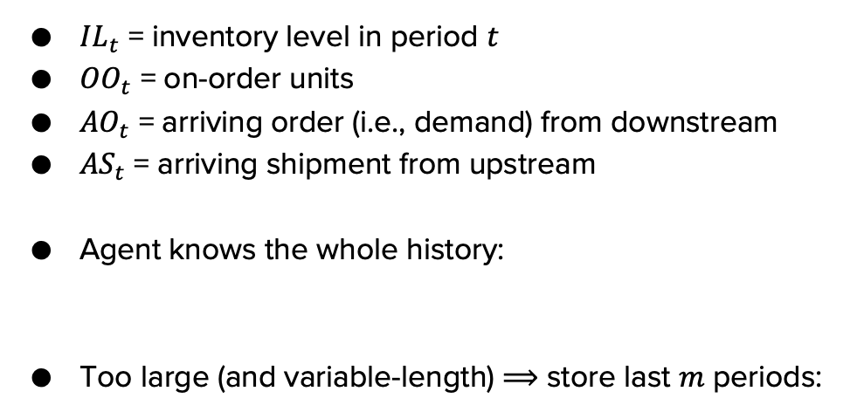
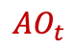
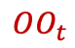
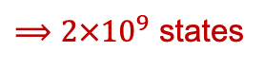
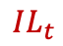
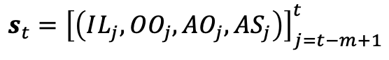
DQN: State space
$$AS_{t}$$
$$OO_{t}$$
$IL_{t}$ = inventory level in period $t$
$OO_{t}$ = on-order units
$AO_{t}$ = arriving order (i.e., demand) from downstream
$AS_{t}$ = arriving shipment from upstream
Agent knows the whole history:
Too large (and variable-length) $⟹$ store last $m$ periods:
$$IL_{t}$$
$$AO_{t}$$
$$\left[\left(IL_{1},OO_{1},AO_{1},AS_{1}\right),…,\left(IL_{t},OO_{t},AO_{t},AS_{t}\right)\right]$$
$${s_{t}=\left[\left(IL_{j},OO_{j},AO_{j},AS_{j}\right)\right]}_{j=t−m+1}^{t}$$
200
100
100
100
10
$⟹2×{10}^{9}$ states

Slide 12
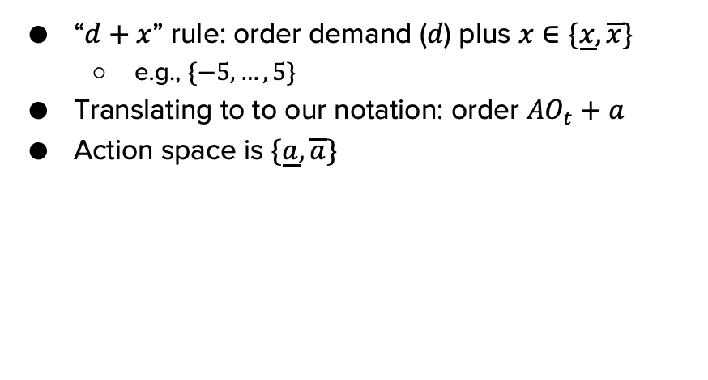
DQN: Action space
“$d+x$” rule: order demand ($d$) plus $x∈\{\underline{x},\overline{x}\}$
e.g., $\{−5, …,5\}$
Translating to to our notation: order $AO_{t}+a$
Action space is $\{\underline{a},\overline{a}\}$

Slide 13
DQN: Rewards
Two problems:
Reward signal is delayed because of lead times
Full reward (system-wide cost) is not observed until end of game
Use reward shaping to address this
During training, update intermediate rewards based on final rewards
“Shaped-reward DQN” (SRDQN)

Slide 14
DQN: Other aspects
DNN
Q-function approximator
Fully connected network, experience replay, etc.
Train on simulated environment
Not stockpyl, but similar idea
Transfer learning

Slide 15
RL vs. classical inventory models
Classical Inventory Models | Inventory Optimization by RL
Stationary parameters | Dynamic environment
Known probability distributions | Imprecise model of uncertainty
Hard to generalize to new constraints, objectives, etc. | Flexible with respect to problem definition
Analytical solutions | Numerical solutions
No training required | Must be trained
RL works well when we have a model of the environment, even if we can’t optimize the environment analytically.
But this also means we need to be able to simulate the environment.

Slide 16
Training
Training requires lots of computational power
Thousands of hours of compute time!
Training data are simulated
Once trained, model can recommend new inventory levels in real time

Slide 17
https://youtu.be/EiabJFqQlHk

Slide 18
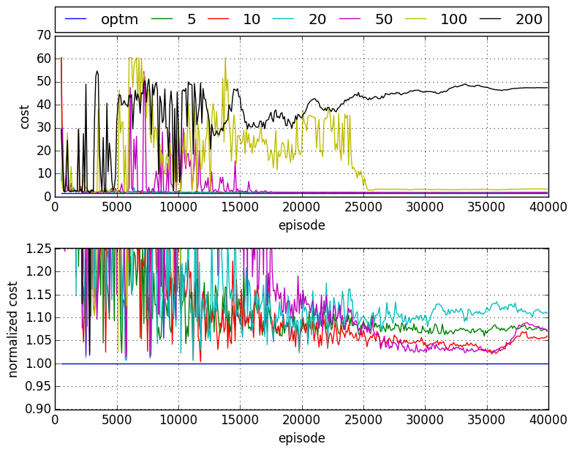

Performance with “rational” (base-stock) teammates

Slide 19
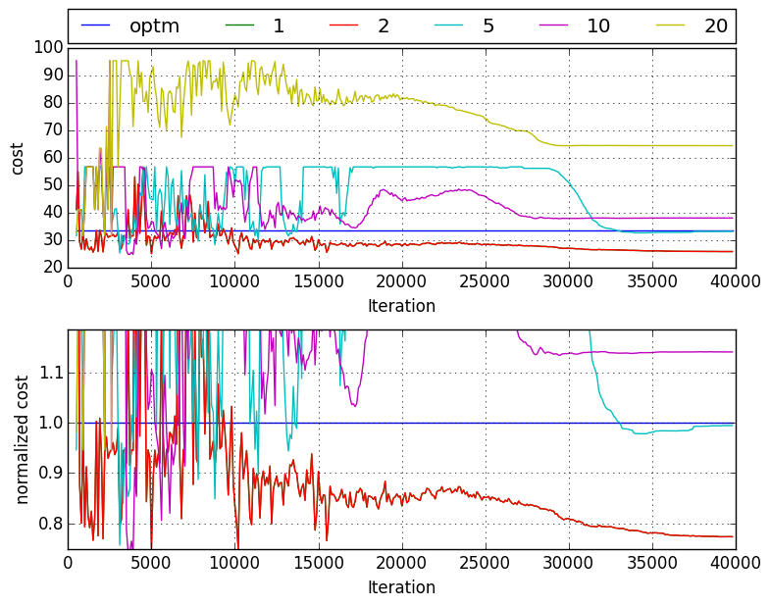
Performance with “human-like” (Sterman) teammates

Slide 20
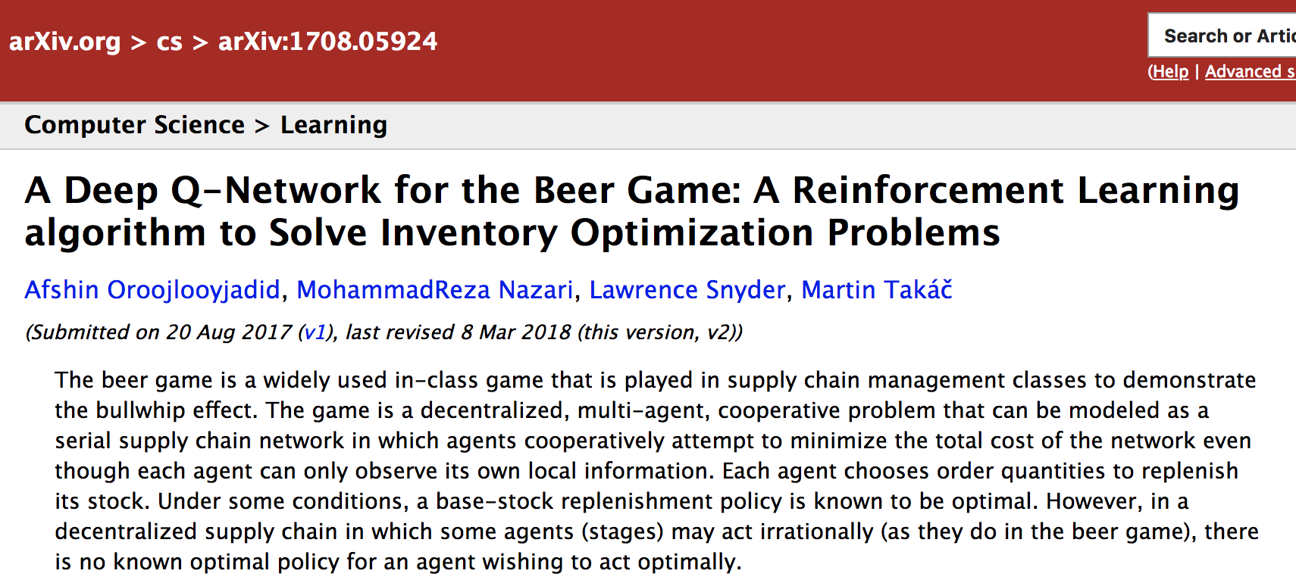
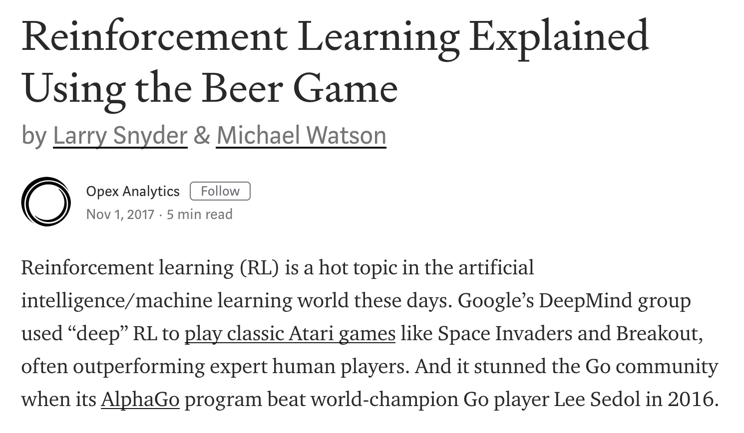
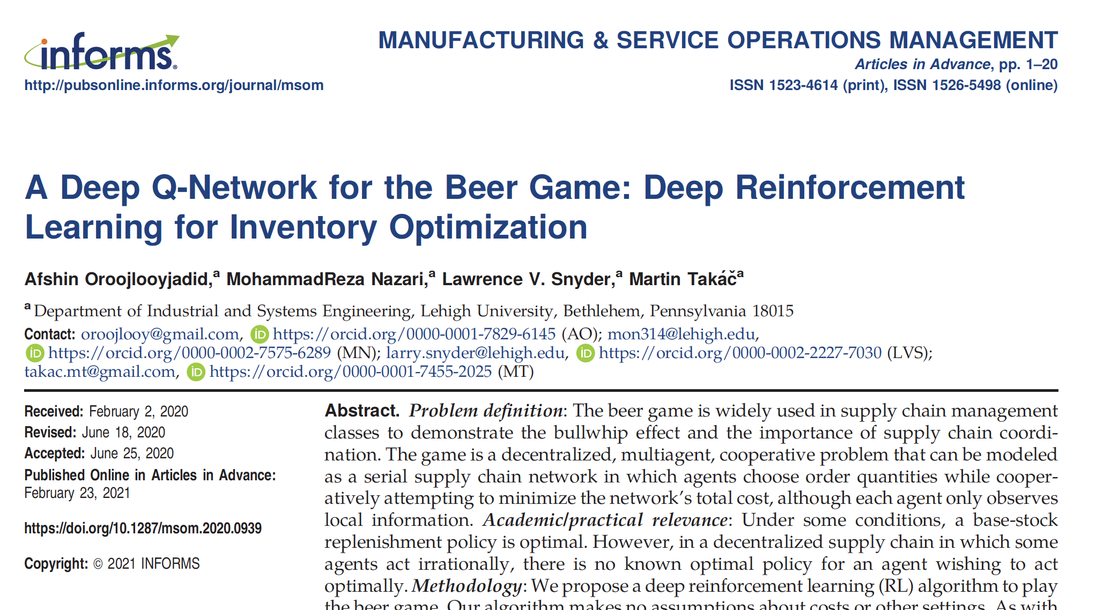
For more info
https://pubsonline.informs.org/doi/abs/10.1287/msom.2020.0939
https://medium.com/opex-analytics/reinforcement-learning-explained-using-the-beer-game-8b4c3b709d2b
Open-source code at https://github.com/beergameAI

Slide 21

The Opex/Llamasoft/Coupa beer game
beergame.opexanalytics.com

Slide 22
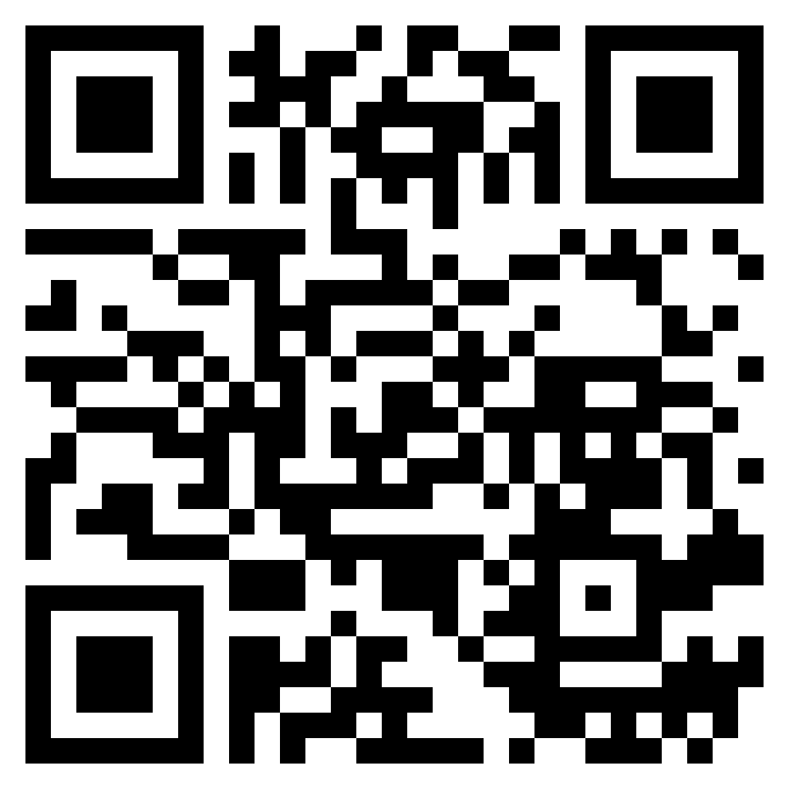
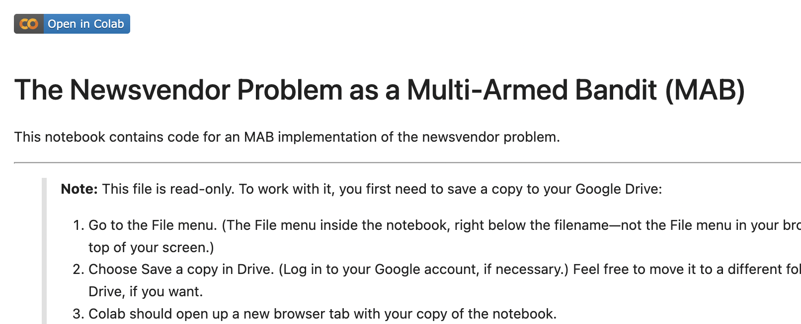
Coding time!
Go to github.com/LarrySnyder/RLforInventory
Click notebooks
Click 3: RL for MPNV.ipynb
Click the “Open in Colab” button:
Follow the directions in the notebook to make your own copy
Work through the notebook at your own pace

Slide 23
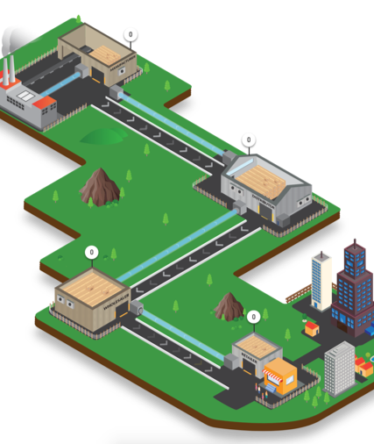

Questions?
larry.snyder@lehigh.edu
https://coral.ise.lehigh.edu/larry/
Supported in part by NSF grants NSF:CCF:1618717, NSF:CMMI:1663256, NSF:CCF:1740796, and XSEDE:DDM180004.

